Slide 1
Codeless Kanban Development 让数据应用最后一公里触手可及
ITC-智能製造処-裴绍锋 June, 2020
Notes:
封面

Slide 2
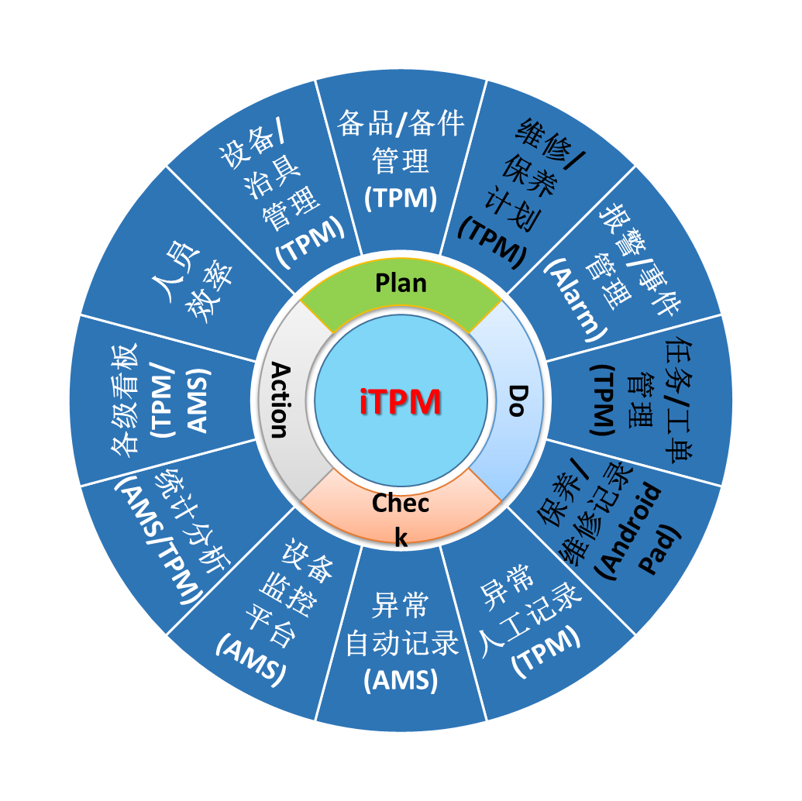
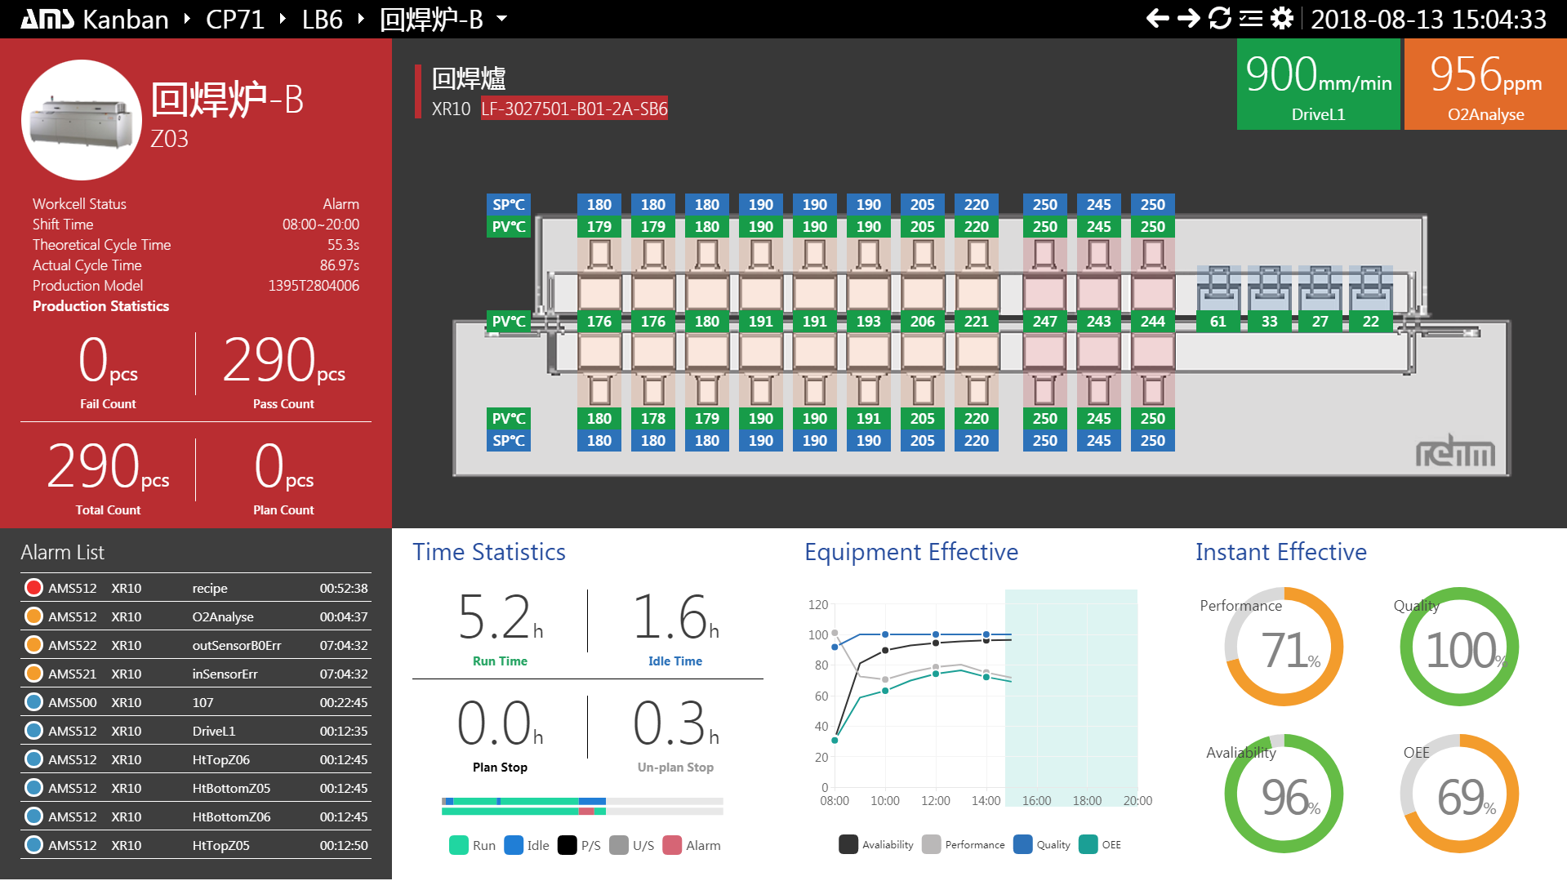
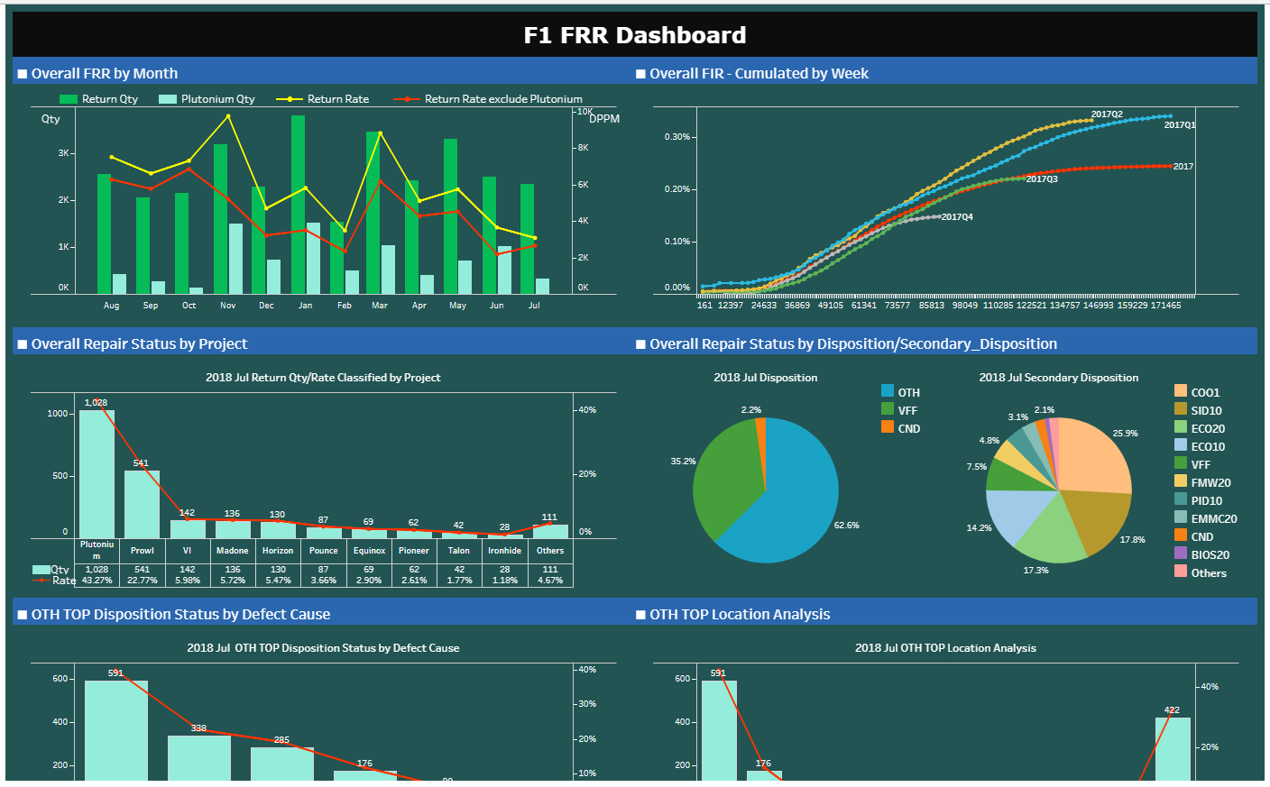
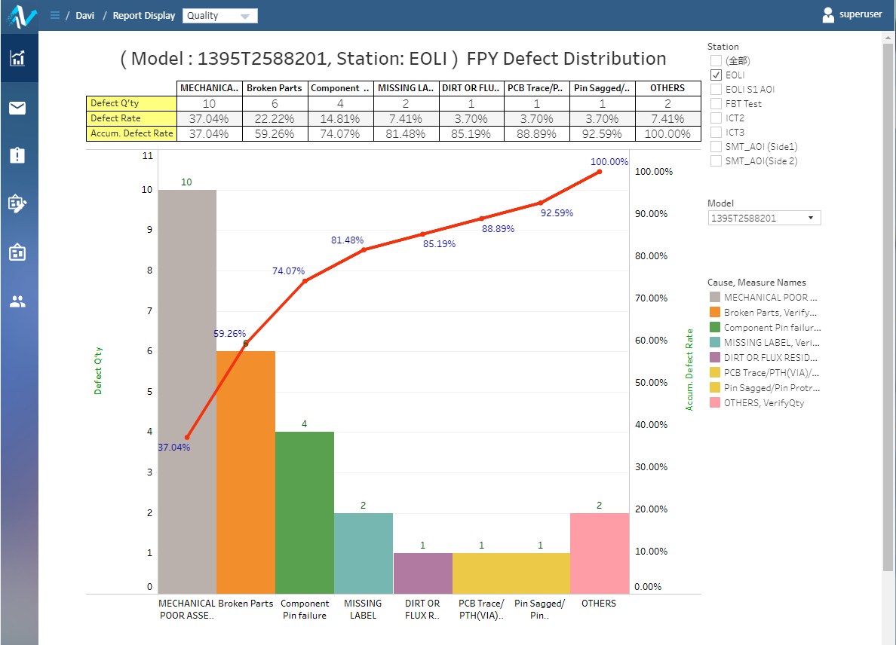
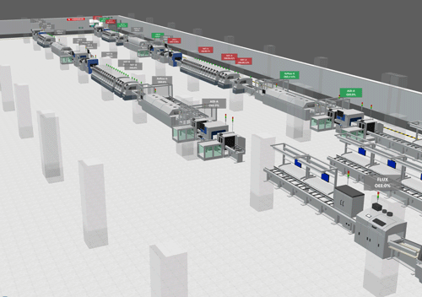







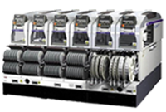

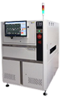
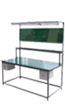
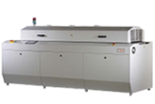
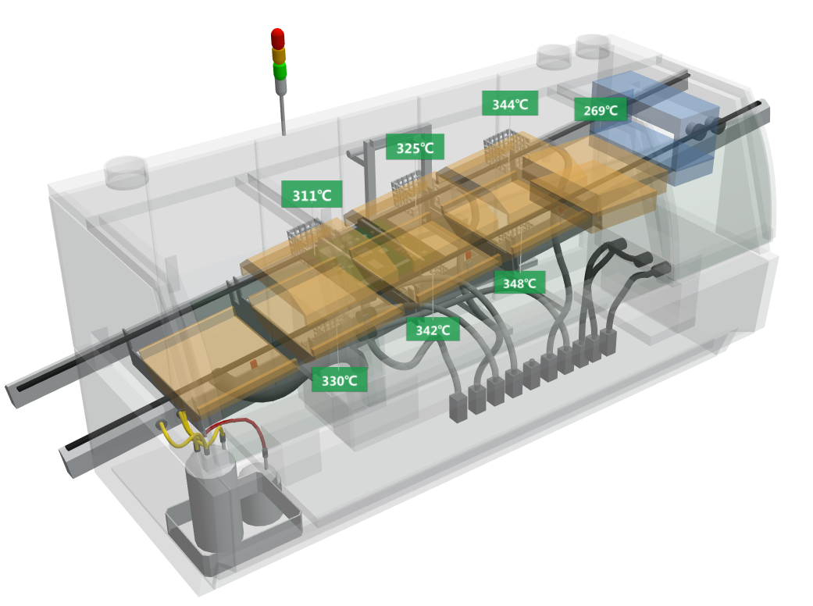
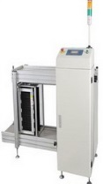
Data Apps – Final Step of All Data
Apps
Data Apps
TPM
Platform
Computing Service
Data Infrastructure
Analytics
Service
Message Bus
IT
Infrastructure
Server / Storage / Network
Virtualization
OLTP @ HA/LB
OLAP @ BigData
Edge
Computing
Node-Red Flow (Common Device)
设备接入
AMS Device Agent (Special Device)

Slide 3


Visualization
Application
Computing
Store
Finding the truth
Processing
Improve efficiency, lower cost
Collection
Data to value

Slide 4


How We Build a Kanban Now
End User
PM
Data Engineer
Back-end
Developer
Front-end
Developer
业务数据库
SP
Web
Kanban
Rest
API

Slide 5


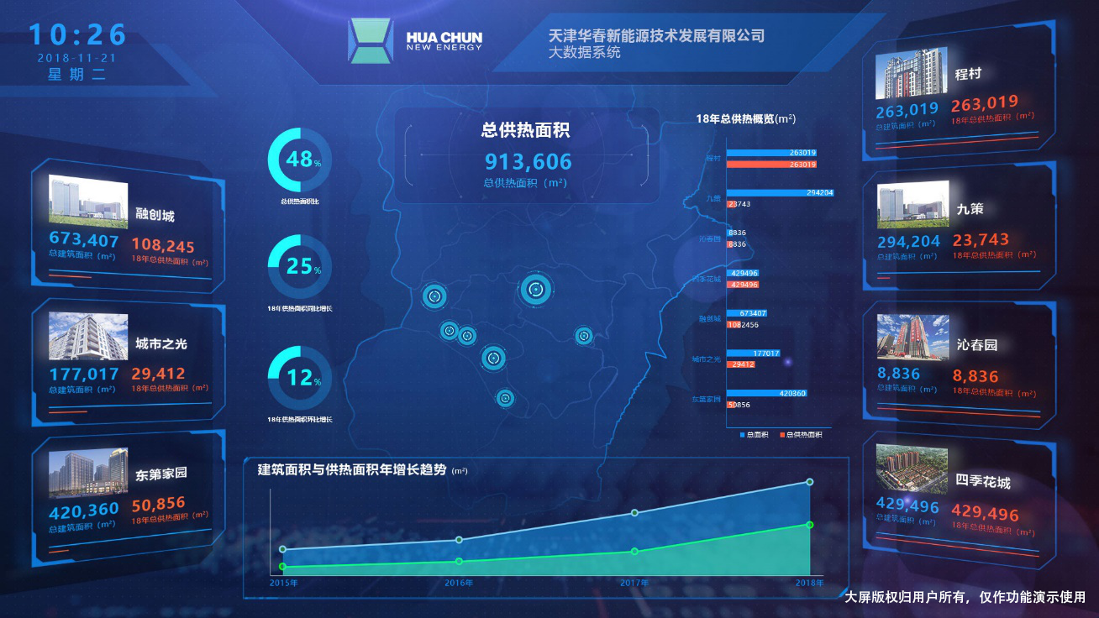

New Mode Base on BDC+Engine
Data Engineer
Data Consumer
Developer
Database & SQL
Process
Quality
Efficiency
Materials
Data Mart
Data Warehouse
with Full Manufacturing Data
Warehouse
P/L Apps
PCA
TPM
RMA
Big Data
Center
Operational Data Source

Slide 6
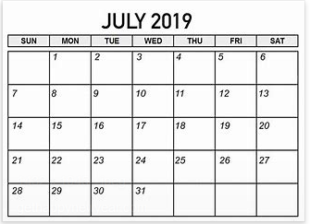
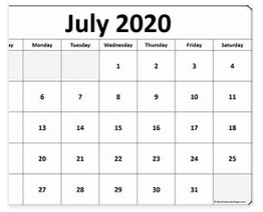
Past
Future
@Tian Jin
@On-Site
H/C
Data Engineer
Back-end
Front-end
Data Engineer
process
Developer centric
Long chain of communication, feedback, know-how transfer
Data Engineer only
Coding/test/deployment free
1 week
1~2 days
Efficiency improved up to 50%~500%
time
1 week

Slide 7
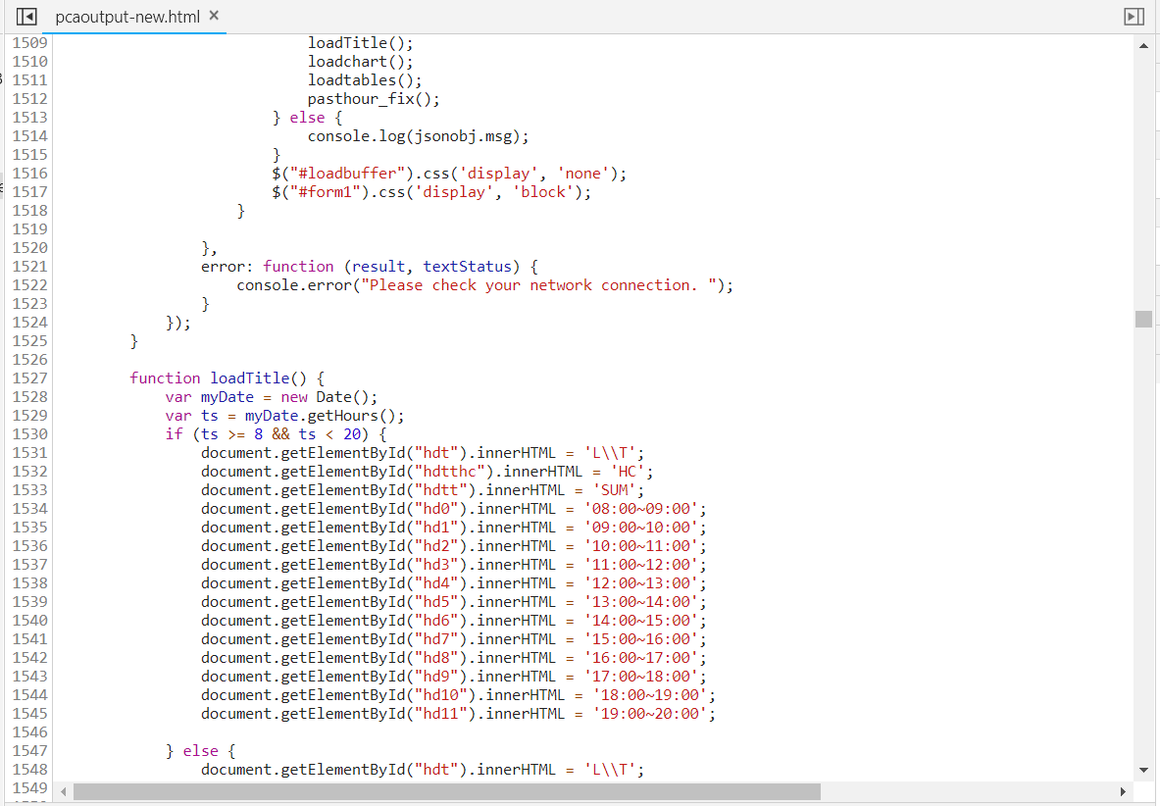
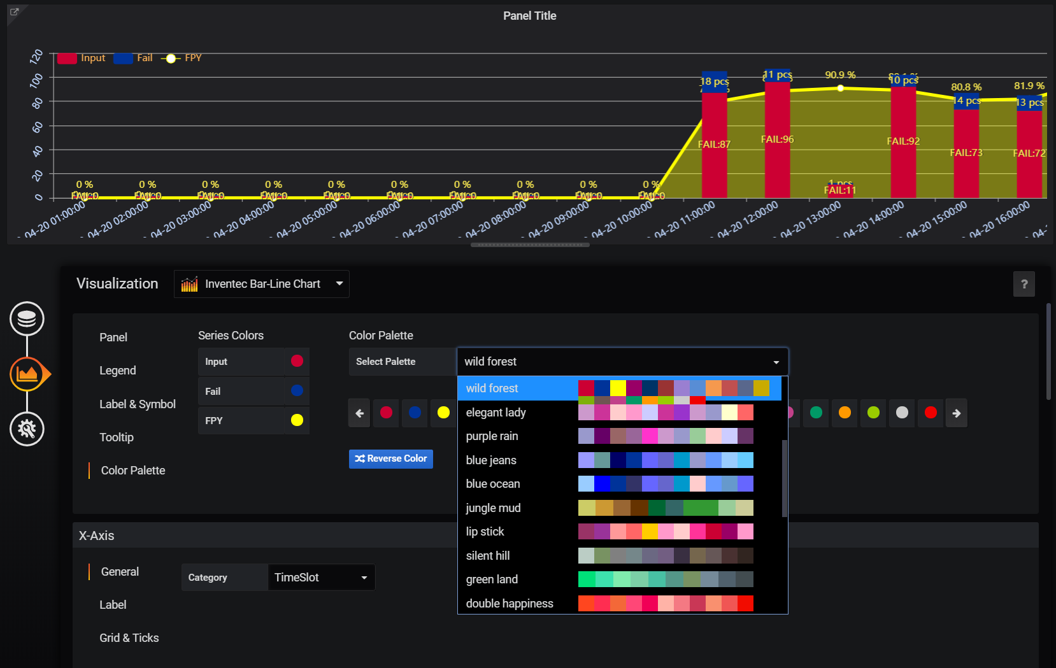
Past
Future
Hard coding mode by developer
Requirement, develop, integration, test, deployment, maintenance
Reuse-less
Configuration mode by data engineer, WYSIWYG
@on-site F2F design/discussion，save means deployed
Standardized component based, unlimited reusable

Slide 8
Live Demo

Slide 9
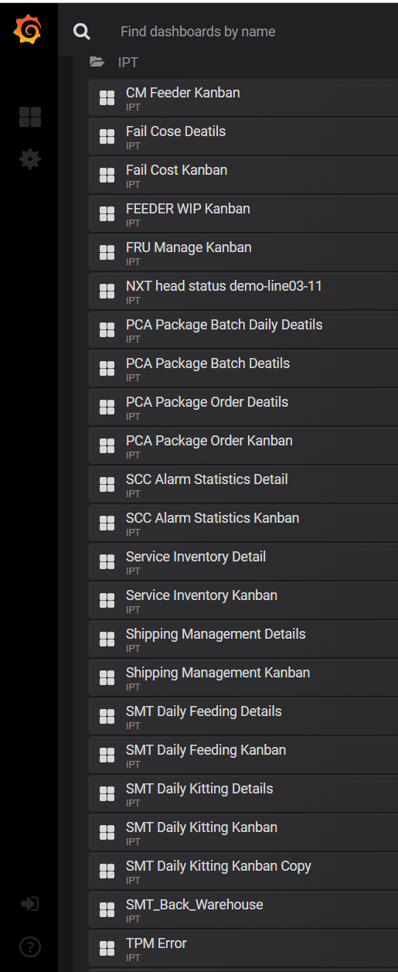
Kanban Built via Grafana
120+
上海，墨西哥，桃园工厂的生产制造，设备管理，测试数据分析，异常追踪等多个应用场景
All TPM Project Kanbans
120+ dashboards in 3 months
CM Feeder管理看板
制造失败成本管理看板
Feeder 维修区WIP看板
FRU生产管理看板
包材订单管理看板
BU2&BU5 Service库存管理看板
出货管理看板
线外备料管理看板
SMT备料管理看板
SMT返仓管理看板
Already deployed Kanban

Slide 10
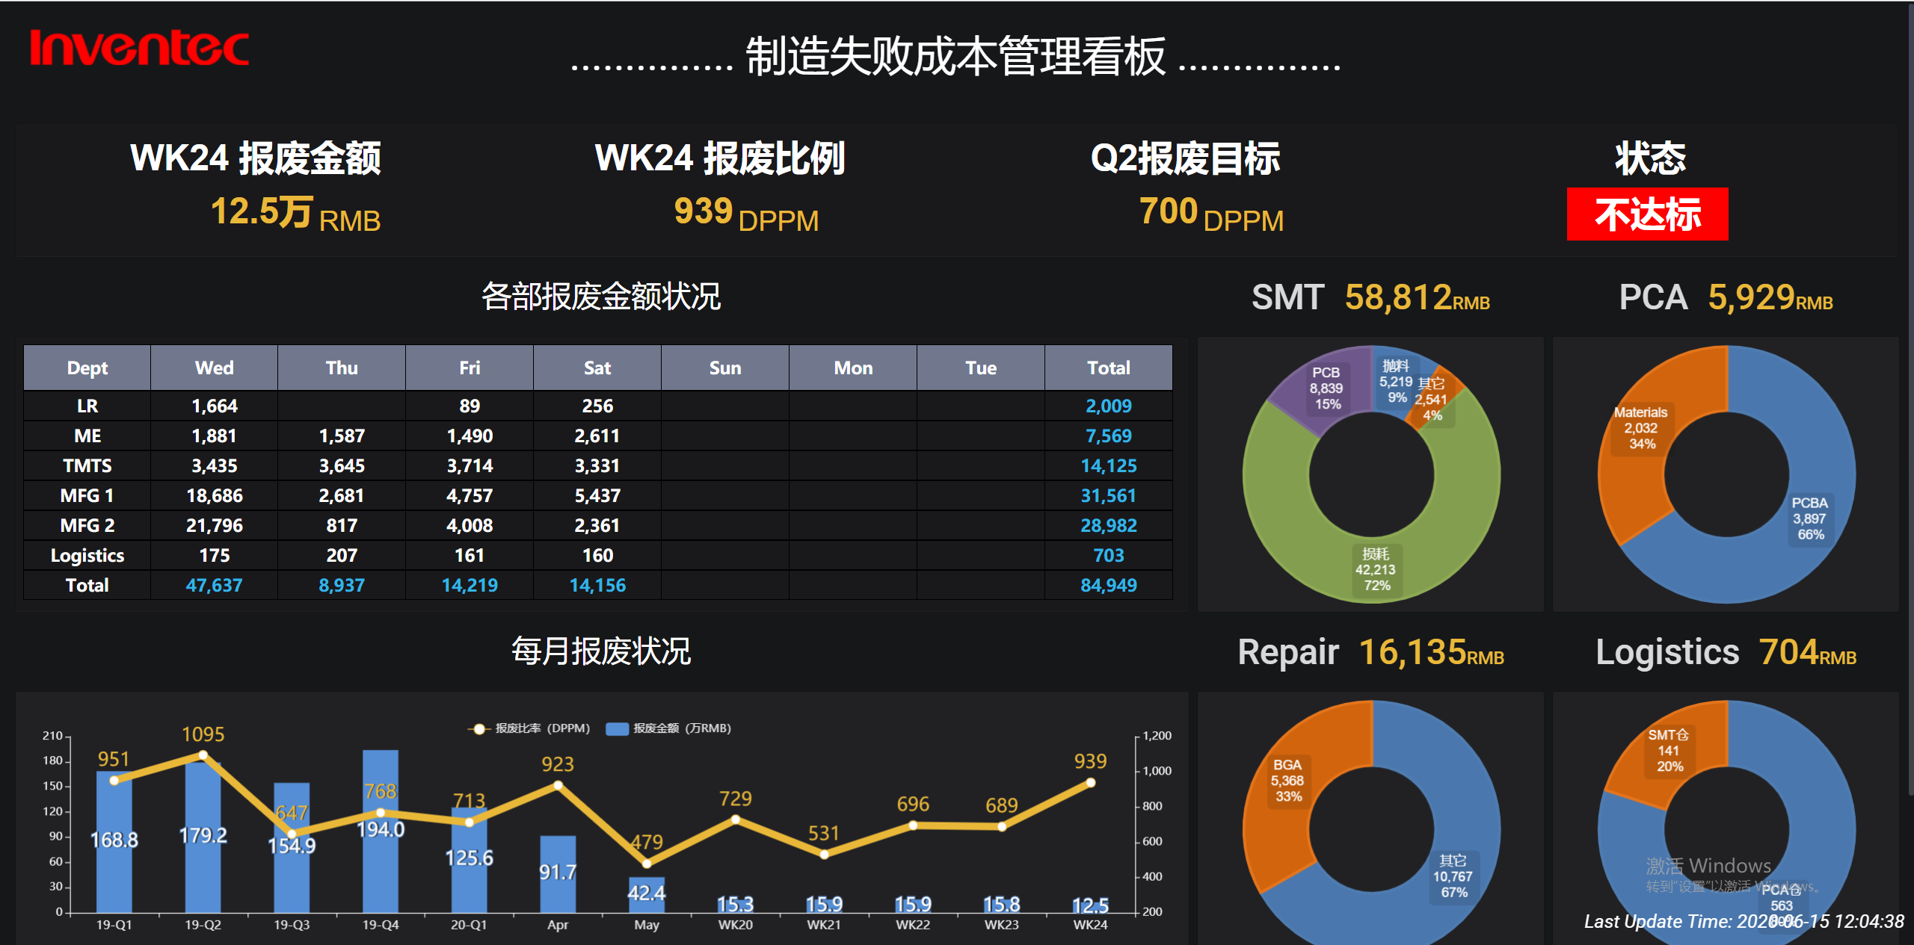

Slide 11
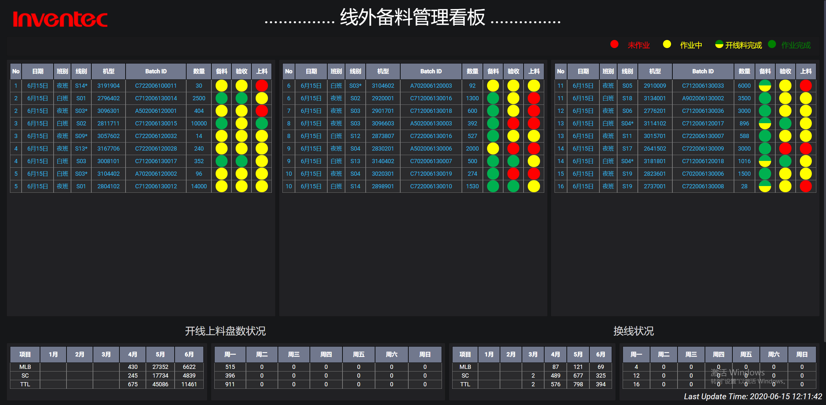

Slide 12
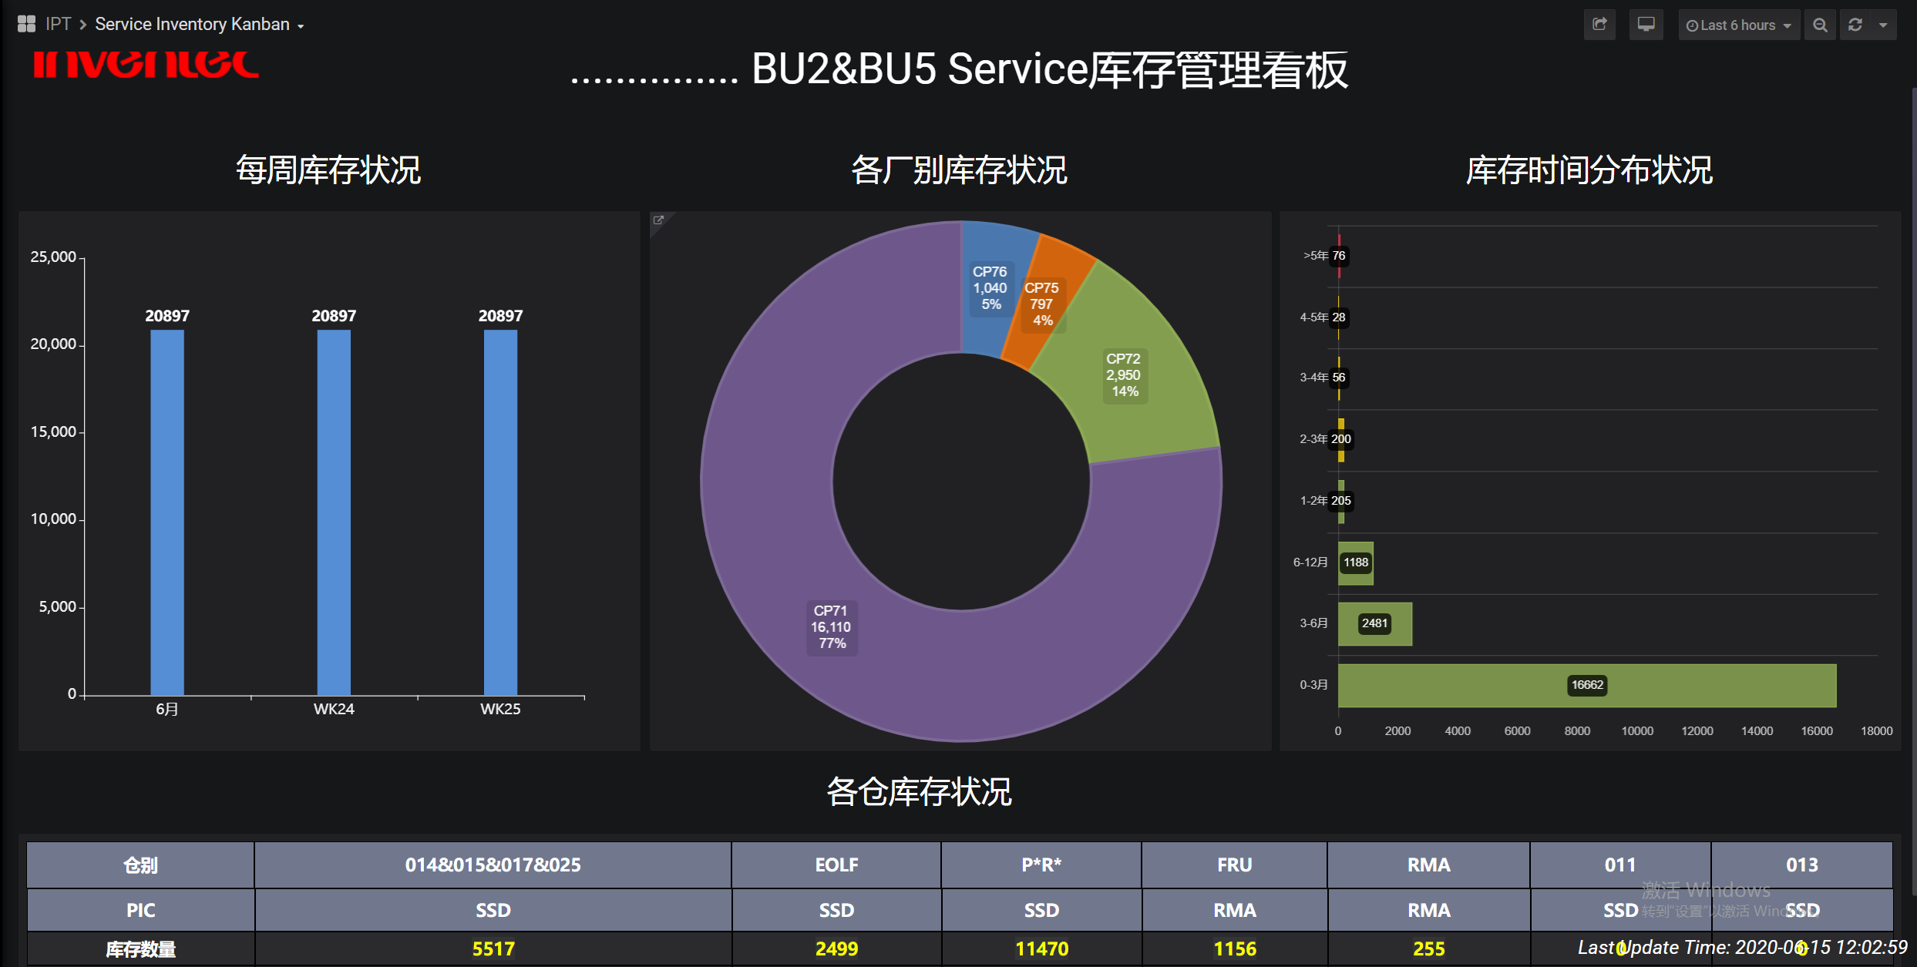

Slide 13
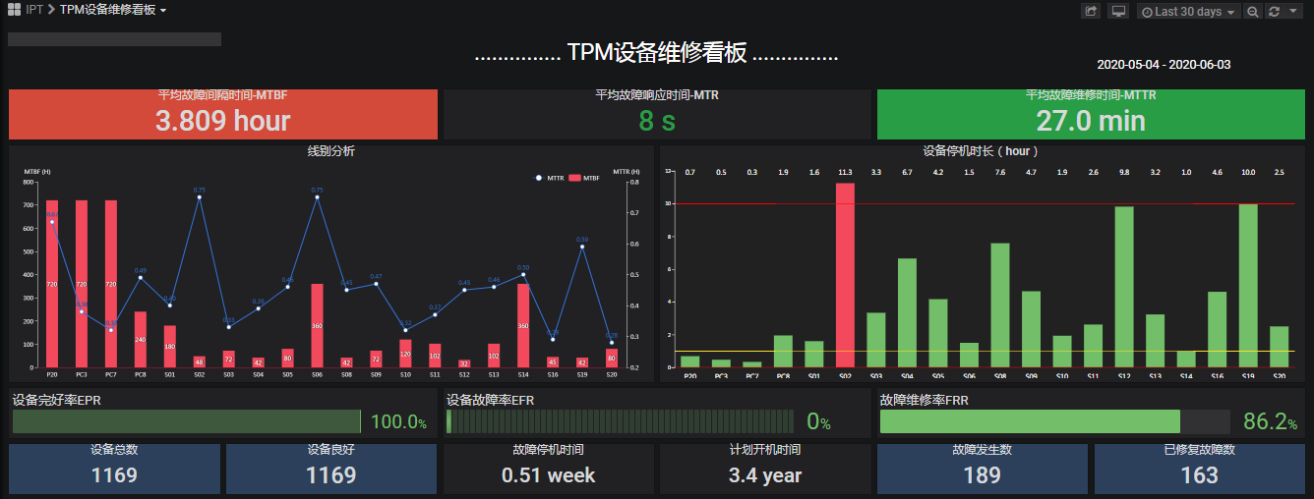

Slide 14
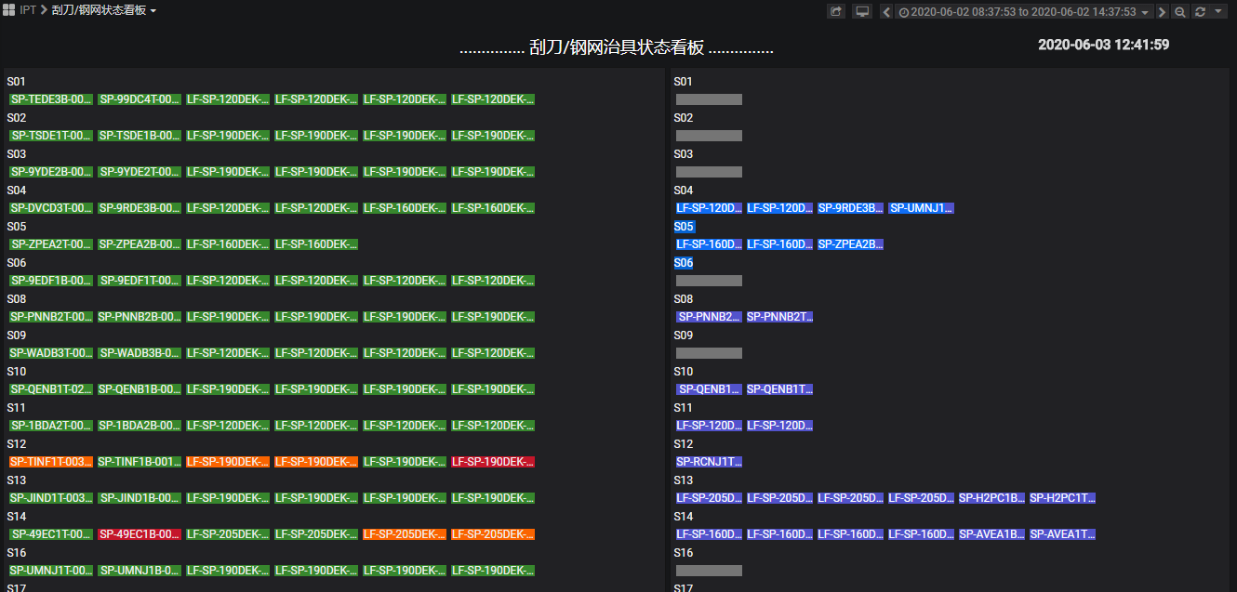
使用TPM 刷出后计算
如果产线下线的用红色
数据刷新MIN
使用online盒子的数据
数据刷新5MIN

Slide 15
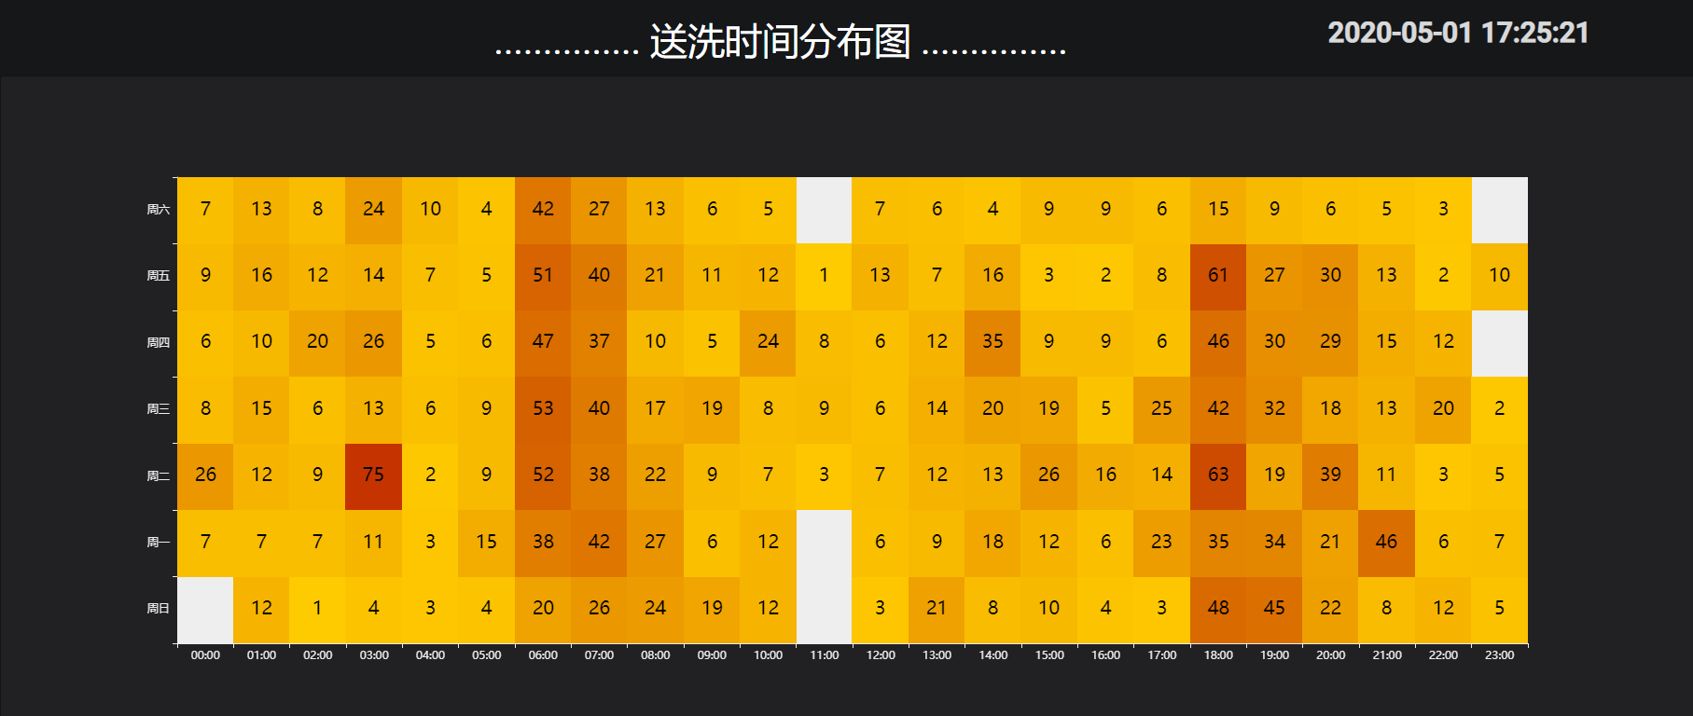

Slide 16
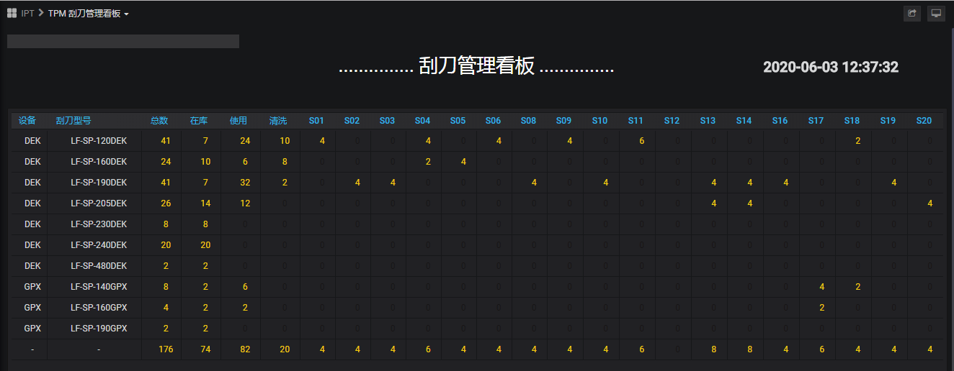
使用TPM的数据
数据刷新5MIN

Slide 17
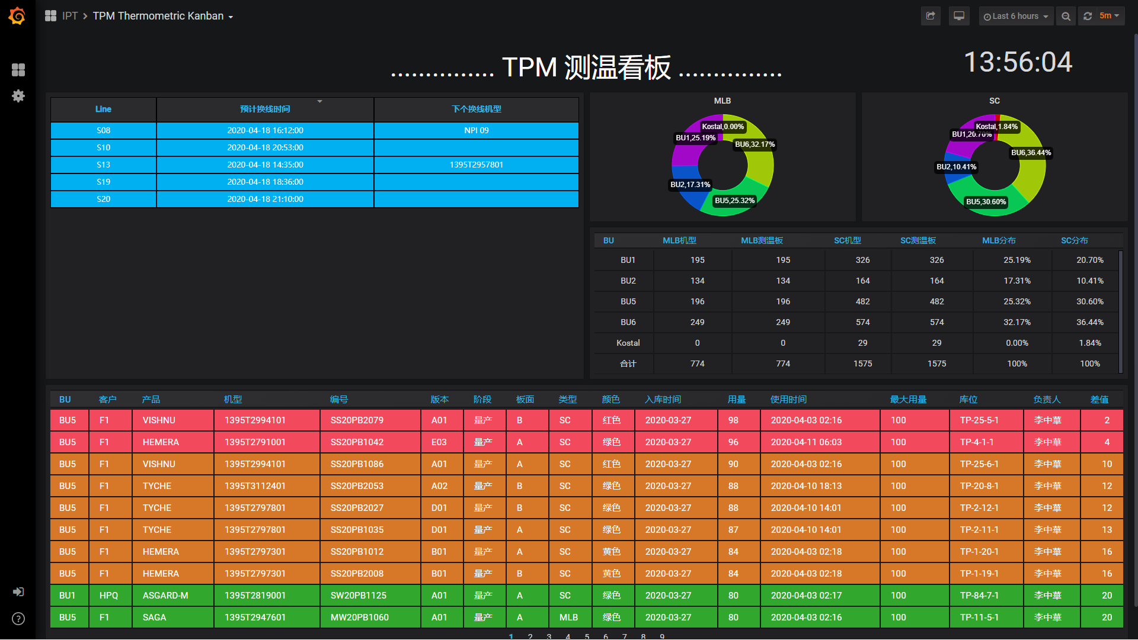

Slide 18
Now We Have
Open-source application, popular and widely used
Lots of 3rd party plugins
We made lots of customization catering our needs
Major Features
90+ Visualization Widgets
69+ Database/Data Source plugins
Full capability of customization or creating new plugins
Dashboard/chart designer
Account and group management
Auto refresh and playlist
Easy copying and sharing
Data export and snapshot
Themes

Slide 19
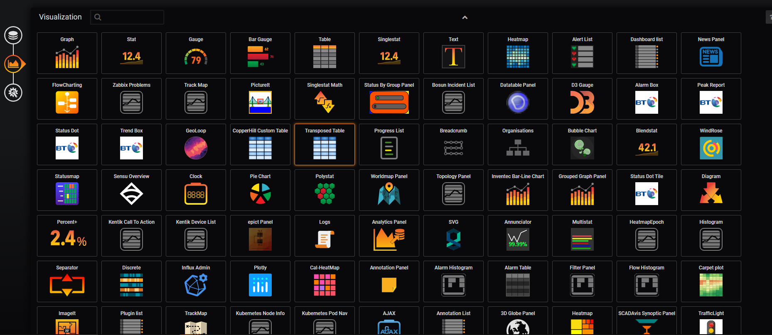
Out-of-Box Widgets

Slide 20
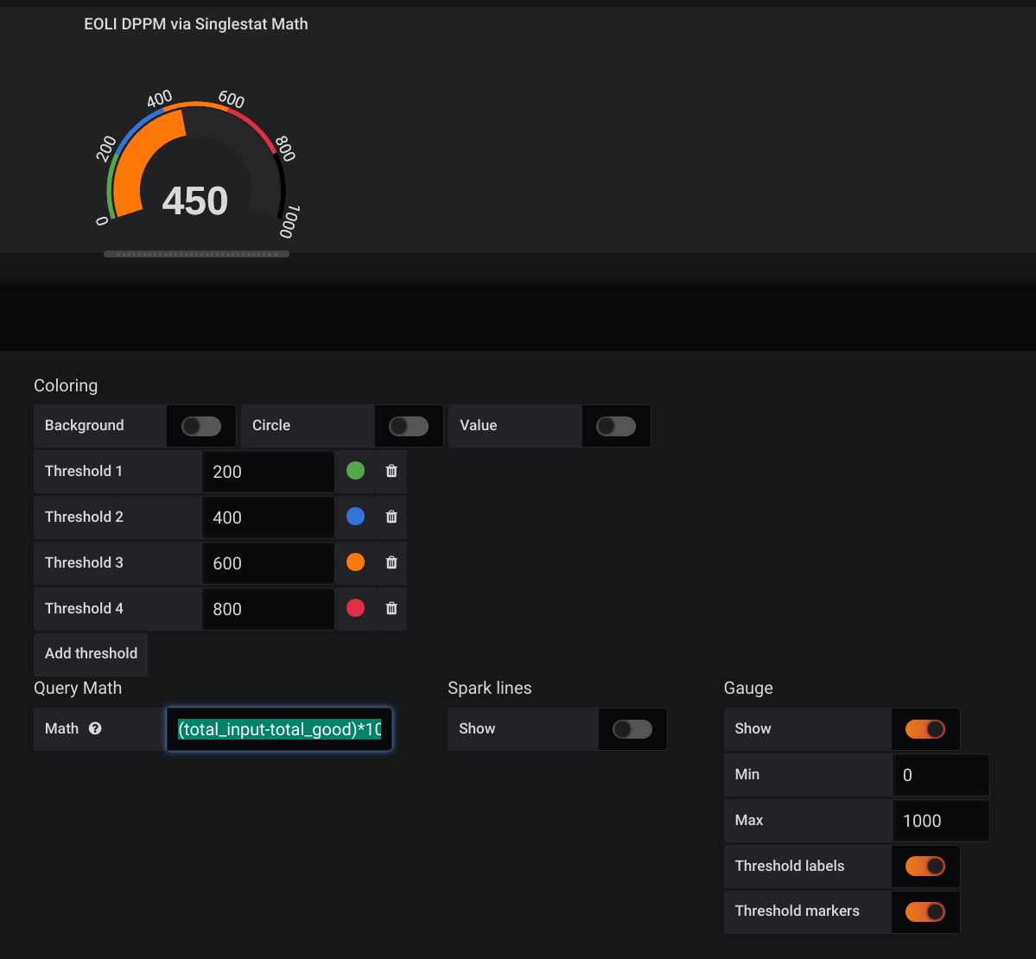
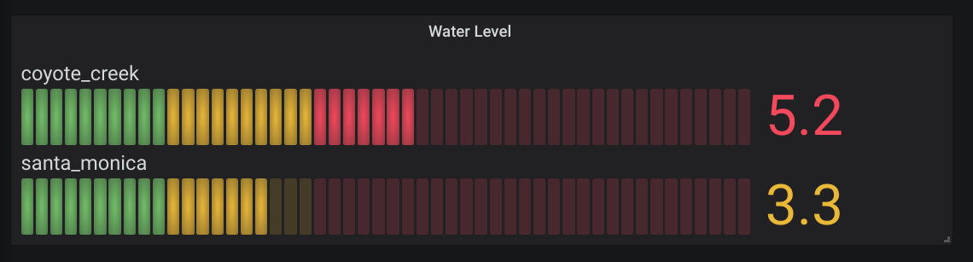
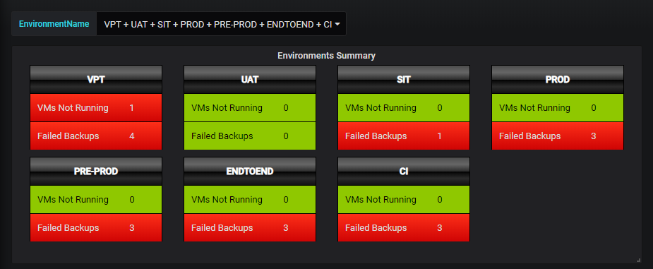
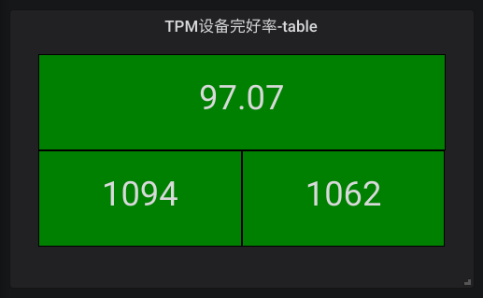
For Statistic Data Display

Slide 21
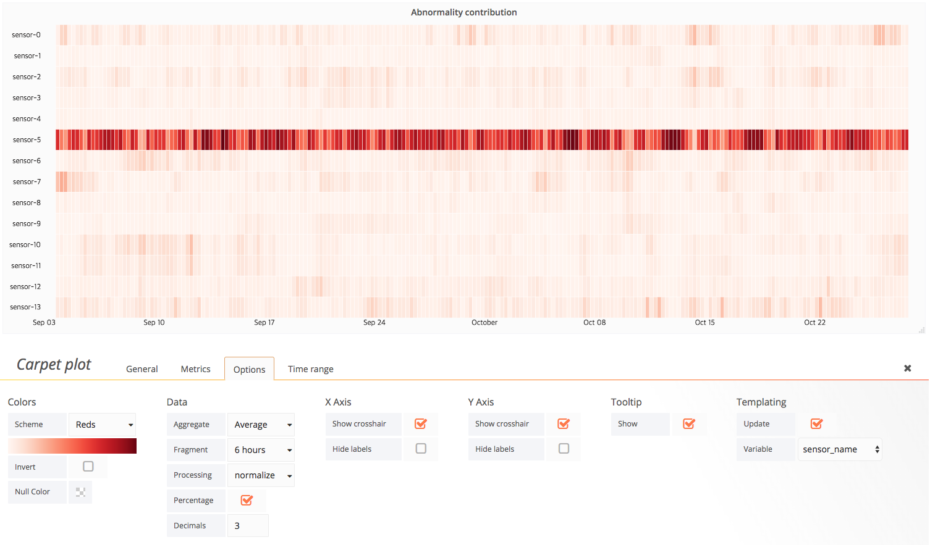
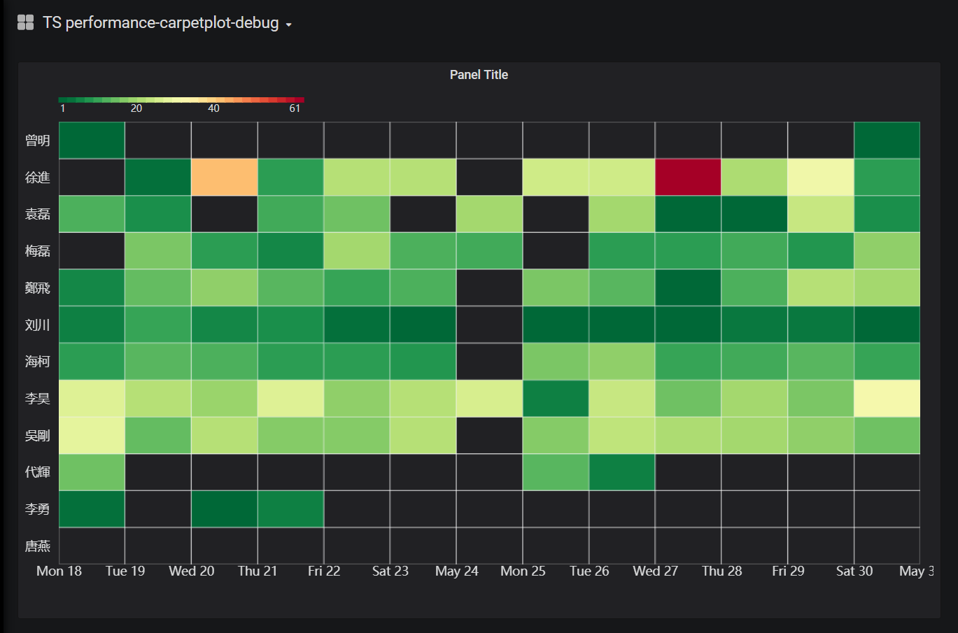
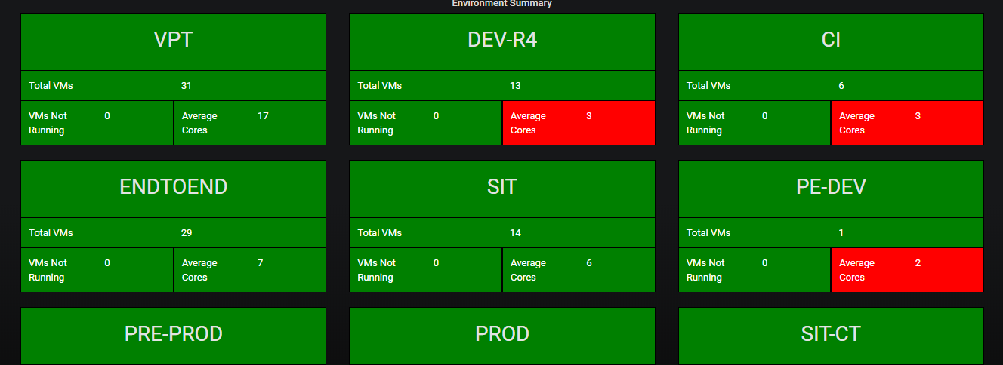
For State/Status

Slide 22
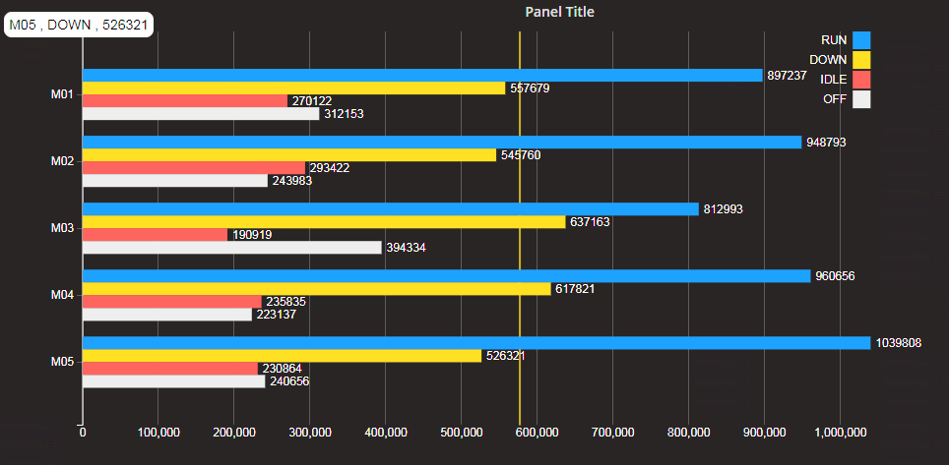
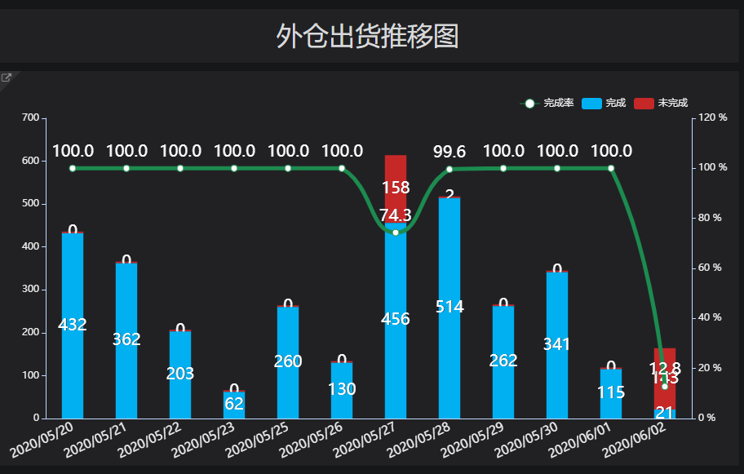
Trend or Comparison

Slide 23
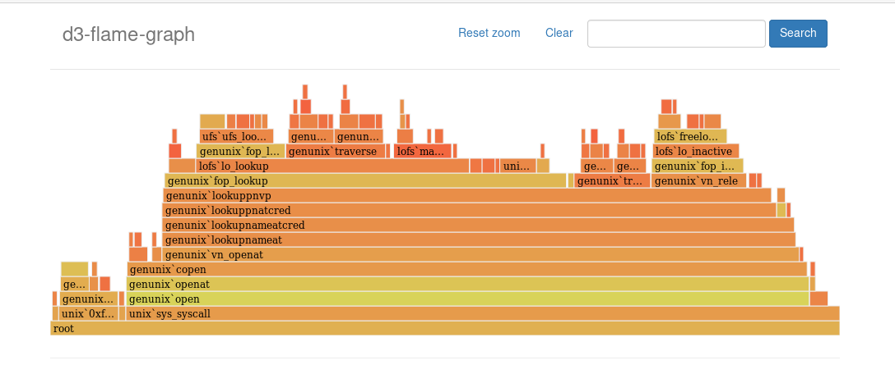
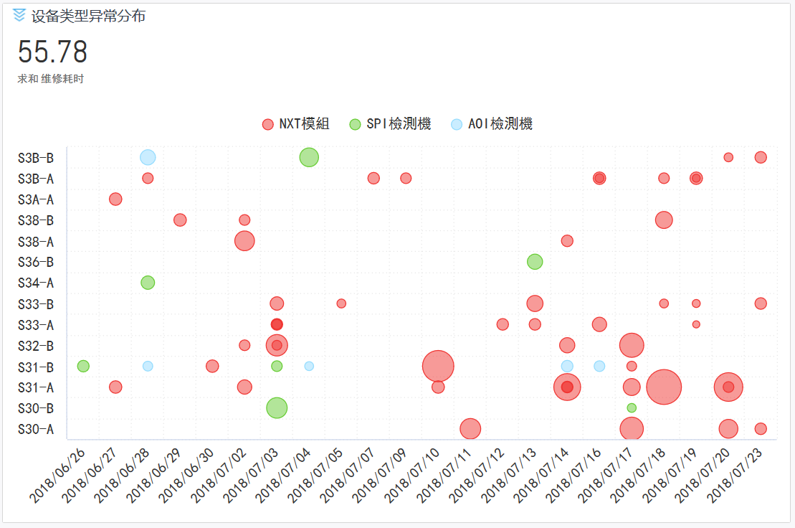
Relationship and Composition

Slide 24
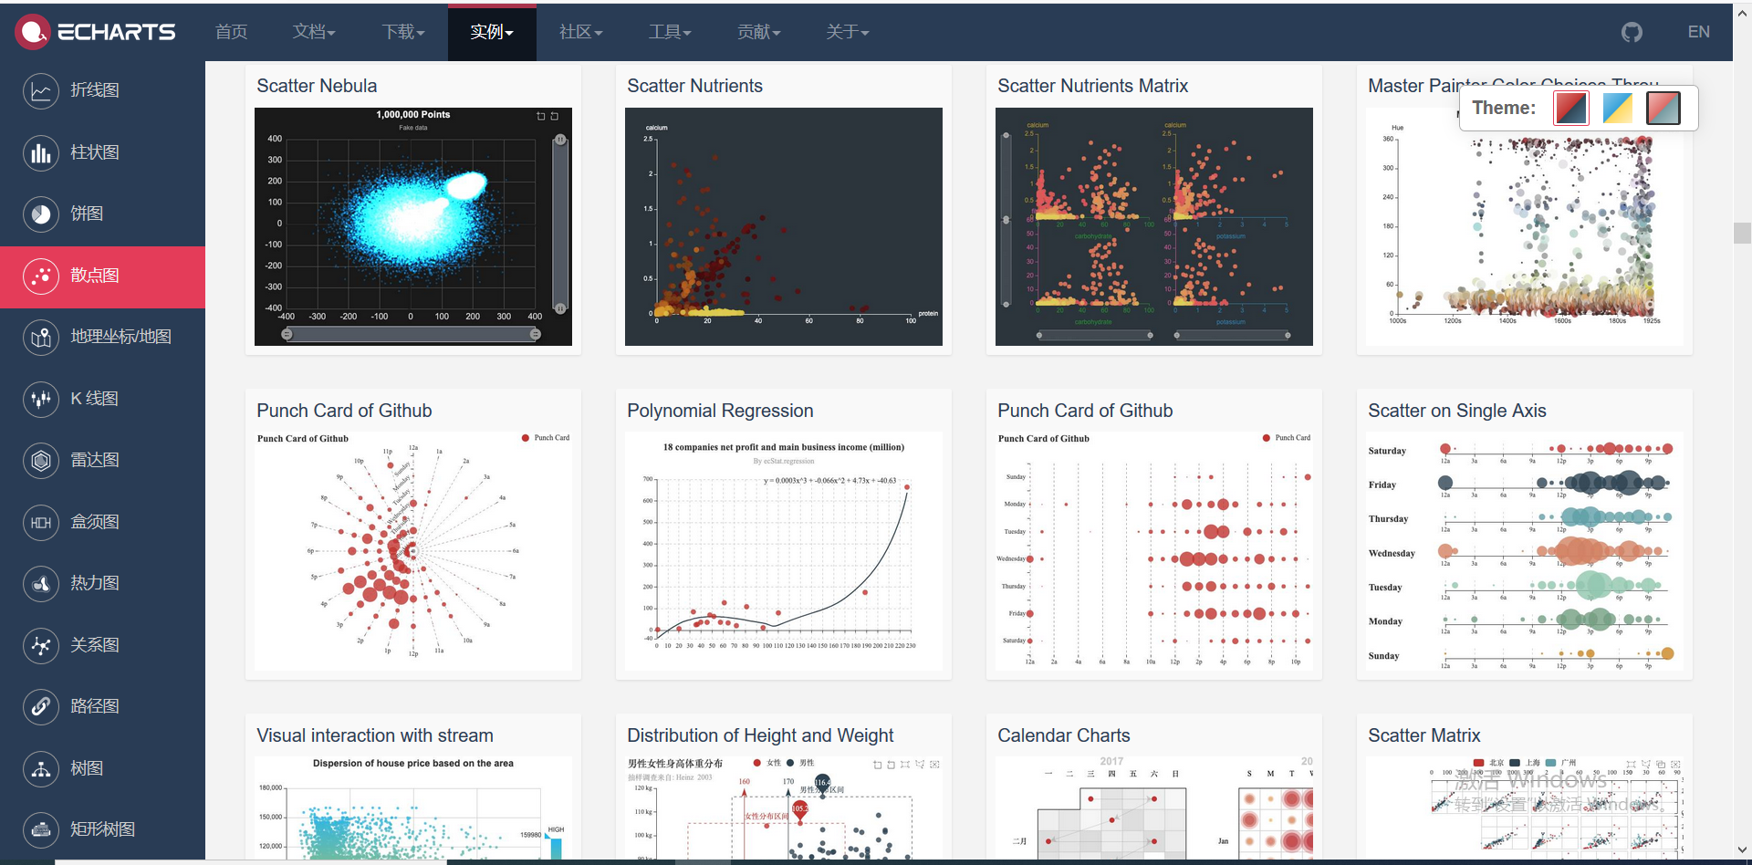
Create New Plugins with Popular Chart Libs

Slide 25


Evolution of Kanban Development
Era of Mechanical
Data Storage
Kanban Design
Coding
Test & Maintanence
Data Processing
Design
Coding ➔ Engine Based
Kanban ➔ Components
Era of Electricity
Era of Intelligence
Big data oriented application
Self-service with convenient toolset
Cover every corner of business

Slide 26

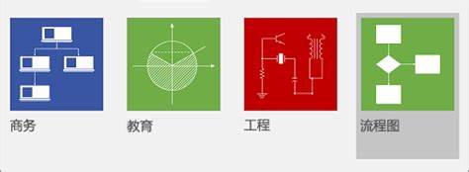
授之以鱼
授之以渔
P/L
Data Engineer
Self-service design
Database
Data Apps
Big Data Center
ITC
Material
Facility Delivery
Data + engine
Process
Quality
Loop still exists
Need knowledge transfer
Efficiency
Trouble
Shooting
Order

Slide 27

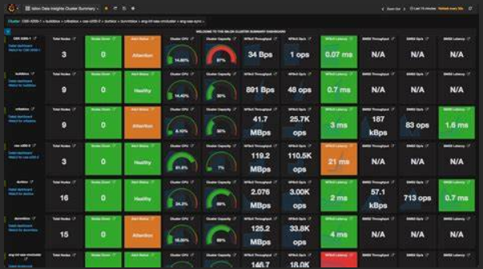
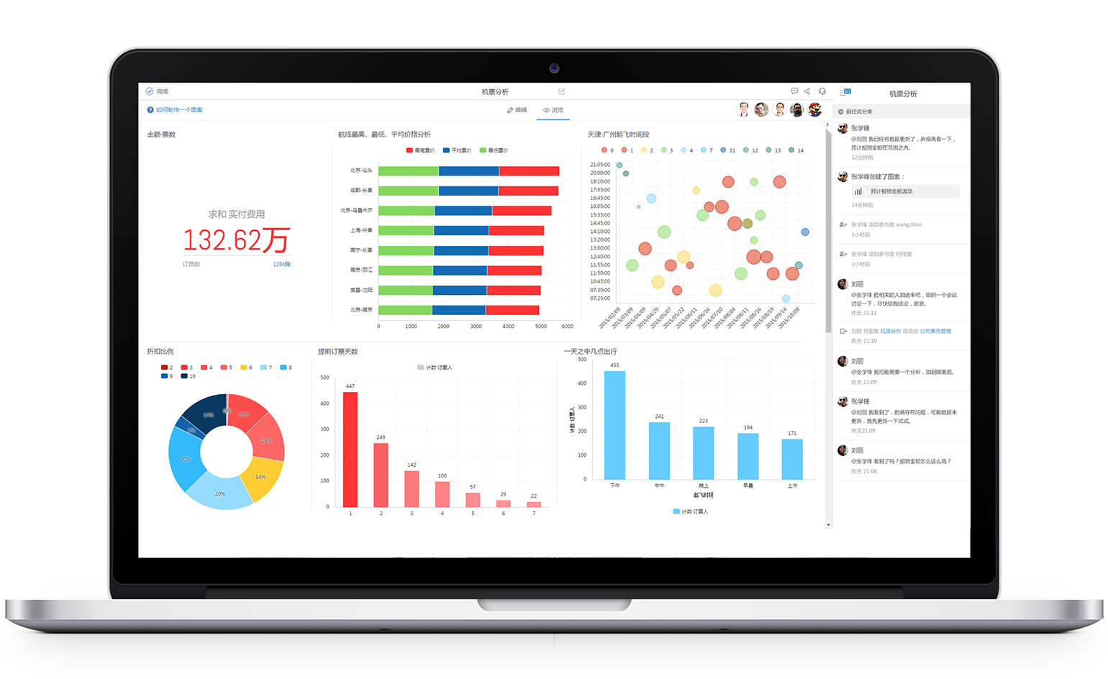

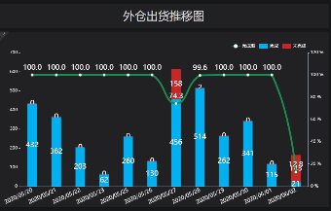
Empower Front-Line w/ Capability of Data Utilization
製造
品質
物流
中心長
Make data using cheap and convenient like water and electricity
客户

Slide 28
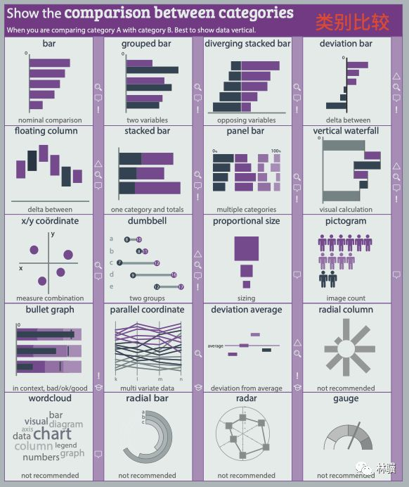
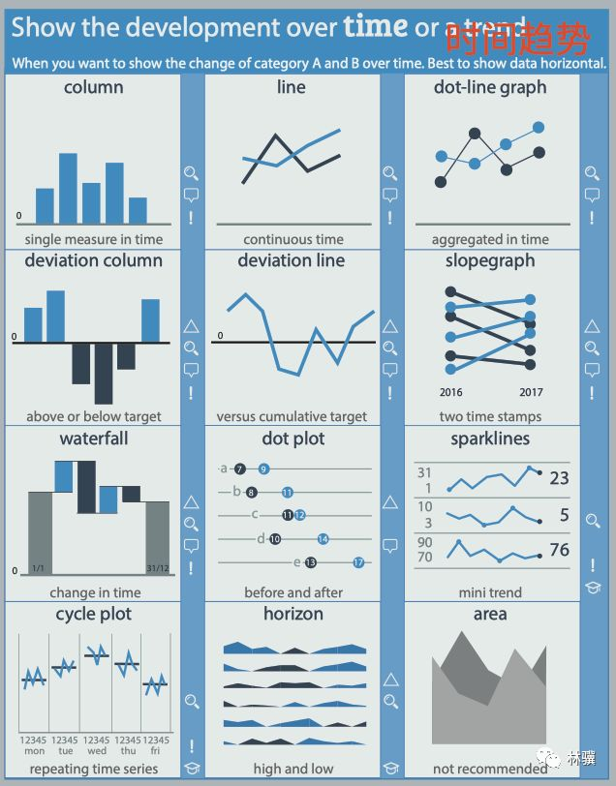
面向类别比较
指标随时间或者其他维度的变化

Slide 29
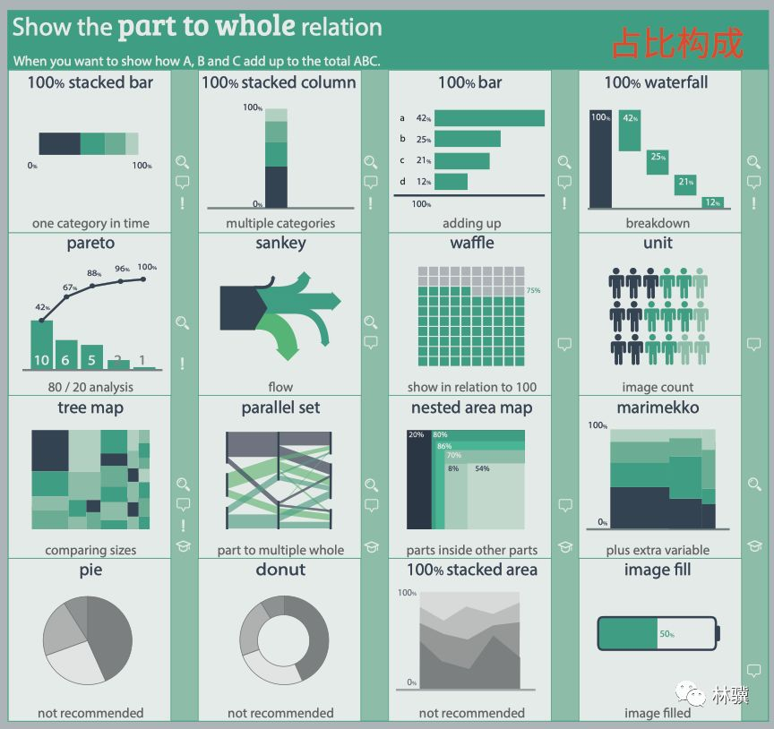
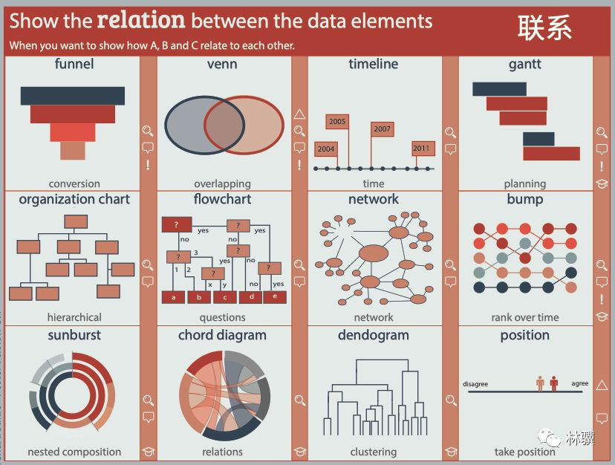
各类别占比
各属性之间关系

Slide 30
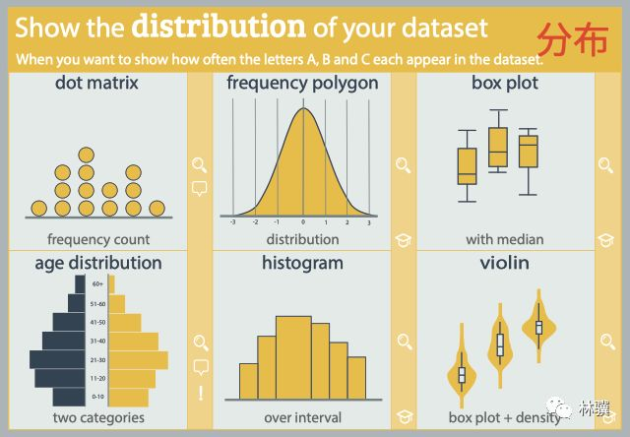
关注数据分布状况

Slide 31
Notes:
封底

